Slide 1

SCHOOL OF ICT
Department of INFORMATION SYSTEMS
Year 3, Trim.I
System Modeling and Simulation (ISY3261)
Prepared by: Mr.Frodouard minani

Slide 2
Indicative Contents
Introduction to modeling and simulations: high-level overview of different categories of simulations, terminology, and Modeling and Simulation practices:
Types of simulations and applications.
Life cycle: Problem formulation, conceptual model development, simulation software development, verification, validation, accreditation, design of experiments, results analysis
Discrete-event simulations and basic concepts – state, time, time advance mechanisms
Randomness and random-number generation

Slide 3
Indicative Contents Cont’
Event-oriented simulations
Process-oriented simulations: Process-oriented world-view and simulation models, relationship to event-oriented models, Simulation languages and primitives.
Queuing network
Agent-based simulation
Practice using ARENA SIMULATION SOFTWARE

Slide 4
Indicative Contents Cont’
Finite-different methods: Initial value problems, Euler methods, Runge-Kutta methods
The Monte Carlo Simulation method
Simulation using ARENA SIMULATION SOFTWARE

Slide 5
Indicative Resources
Discrete-Event System Simulation (Fourth Edition), Banks, Carson, Nelson, and Nicol, Prentice-Hall, 2005.
Simulation Modeling and Analysis (Third Edition), Law and Kelton, McGraw Hill, 2000.

Slide 6
Chapter 1
Introduction to modeling and simulations

Slide 7
Introduction To Modeling and Simulation (Outline Contents)
What is Modeling and Simulation (M&S) ?
Model Classification
Simulation Types
Some Application Areas of M&S
Advantages, disadvantages, and pitfalls in a simulation study
M&S Terms and Definitions
What is simulation?
How to study a system?
When to use simulations?
Terminology – system, state, events
Steps in a simulation study

Slide 8
What is M&S ?
Discipline of understanding and evaluating the interaction of parts of a real or theoretical system by: –Designing its representation (model) and – Executing (running) the model including the time and
space dimension (simulation).

Slide 9
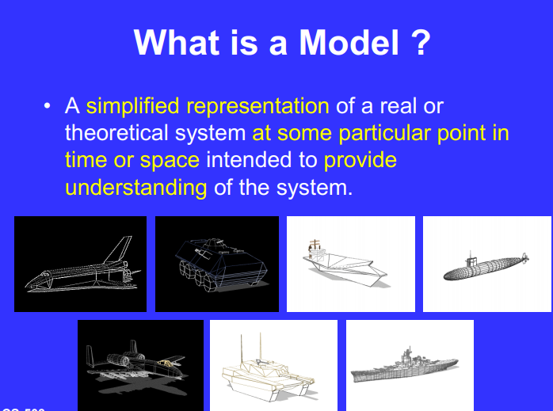

Slide 10
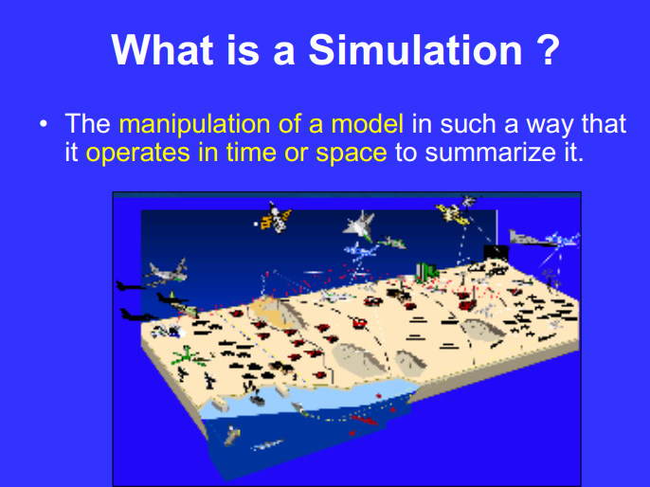

Slide 11
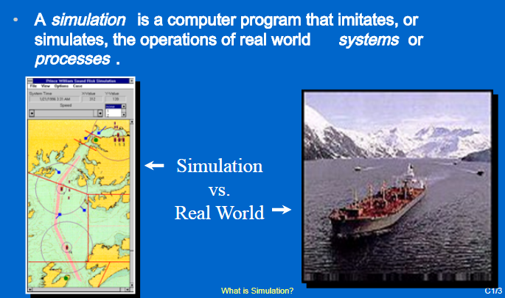
Another definition of Simulation

Slide 12
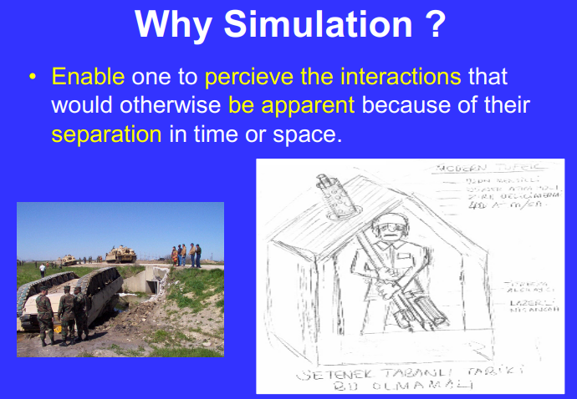
To understand or perceive how the real system works in time or space.

Slide 13
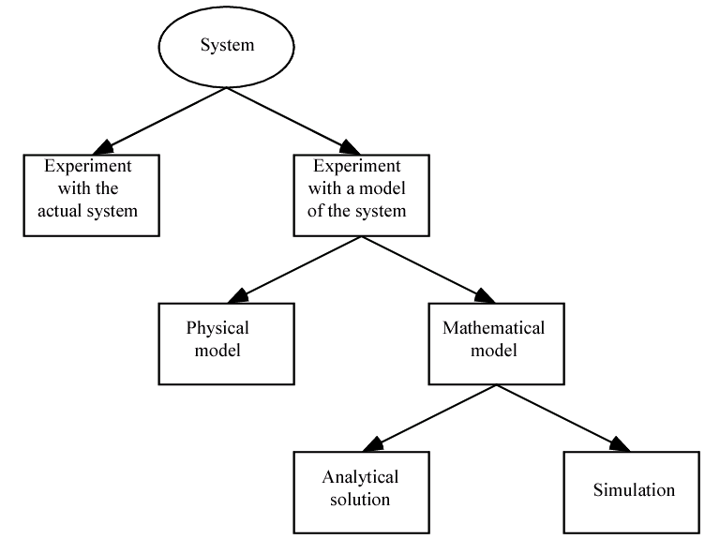
How to study a system?

Slide 14
When to use simulations?
Simulations can be used:
To study complex system, i.e., systems where analytic solutions are infeasible.
To compare design alternatives for a system that doesn’t exist.
To study the effect of alterations to an existing system. Why not change the system??
To reinforce/verify analytic solutions.
Simulations should not be used:
If model assumptions are simple such that mathematical methods can be used to obtain exact answers (analytical solutions)

Slide 15
Advantages of M&S
Results are accurate in general, compared to analytical model.
Help to find un-expected phenomenon, behavior of the system.
Can be used to study complex systems that would otherwise be difficult to investigate.
Can be used in engineering and product design to investigate the effect of changes without producing a physical prototype.
Simulation is flexible, hence changes in the system variables can be made to select the best solution among the various alternatives.
Can be used to investigate situation that would be dangerous in real life.

Slide 16
Disadvantages of M&S
Formula and functions that are used may not provide an accurate description of the system resulting in inaccurate output from the simulation
It may take a long time to develop a good simulation model.
In certain cases simulation models can be very expensive.
The decision-maker must provide all information (depending on the model) about the constraints and conditions for examination, as simulation does not give the answers by itself.
Simulation results may be difficult to interpret.

Slide 17
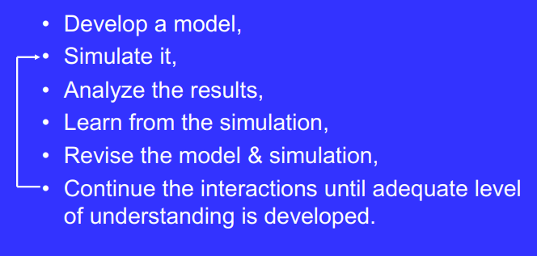
How to Use a Simulation ?

Slide 18
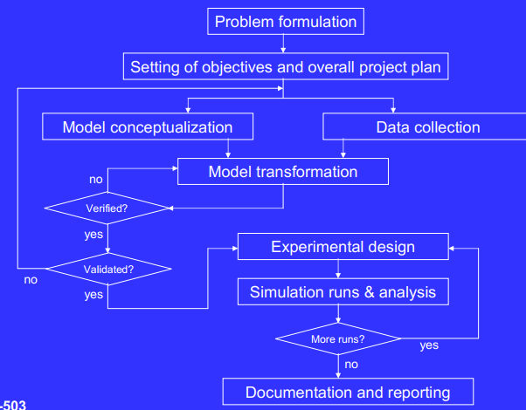
Steps in a M&S Study

Slide 19
Typical Uses of Simulation
Estimating a set of productivity measures in production systems, inventory systems, manufacturing processes, materials handling and logistics operations.
Designing and planning the capacity of computer systems and communication networks so as to minimize response times.
Conducting war games to train military personnel or to evaluate the efficacy of proposed military operations
Improving health care operations, financial and banking operations, transportation systems and airports, among many others.

Slide 20
Some Application Areas of M&S Cont’
Manufacturing Applications
Analysis of storage and retrieval strategies in a warehouse.
Investigation of dynamics in a service oriented supply chain.
Construction Engineering
Construction of a dam embankment (An embankment dam is a large artificial dam).
Activity scheduling in a dynamic, multi-project setting.
Investigation of the structural steel erection process.

Slide 21
Some Application Areas of M&S Cont’
Military Applications
Modeling leadership effects and recruit type in a Army recruiting station.
Design and test of an intelligent controller for autonomous underwater vehicles.
Modeling military requirements for non-warfighting operations.
Logistics, Transportation and Distribution Applications
Evaluating the potential benefits of a rail-traffic planning algorithm.
Evaluating strategies to improve railroad performance.
Analysis of passenger flows in an airport terminal.
Proactive flight-schedule evaluation.
Production distribution in newspaper industry.
Choosing between rental-car locations.

Slide 22
Some Application Areas of M&S Cont’
Healthcare:
Emergency, operating rooms
Computer Systems:
Telecommunications

Slide 23
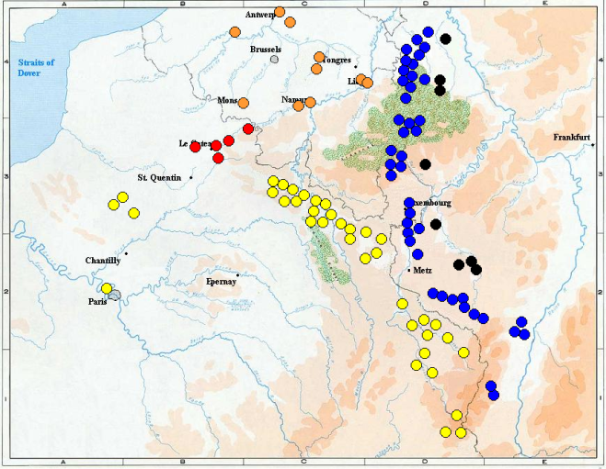
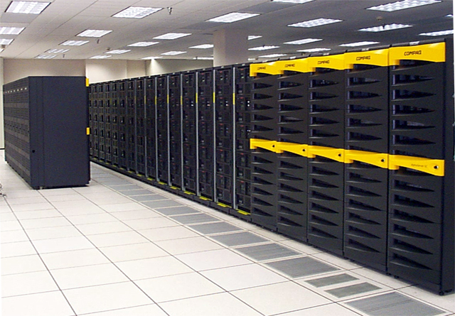
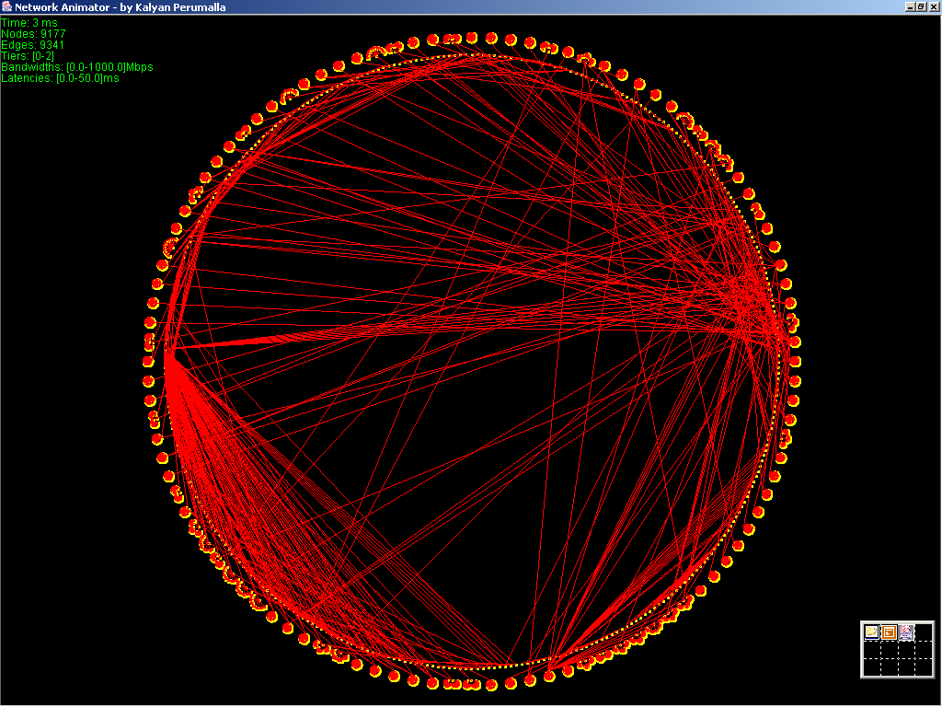
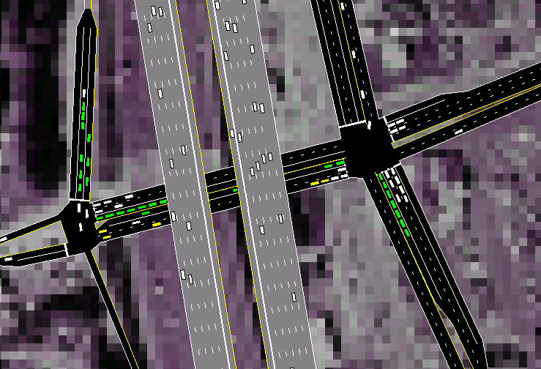
A Few Example Applications
Wargaming: test strategies; training
Transportation systems: improved operations; urban planning
Parallel computer systems: developing scalable software
Computer communication
network: protocol design

Slide 24
Terminology
System: A collection of objects that act and interact together toward some logical end
E.g. Determine number of cashiers needed to provide express service to customers with 10 or less item at a superstore – system consists of express cashiers and customers with 10 or less items
State of a system: Collection of variables and their values necessary to characterize a system at a particular time
Might depend on desired objectives, performance measures
SS Example: # of express cashiers, time of arrival of customers with 10 or less items, etc.
Event: A change in system state
Customer arrival, start of service, and customer departure

Slide 25
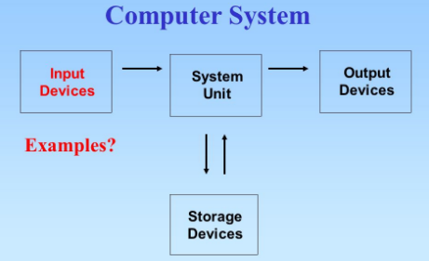
Systems
A system is a collection of elements or components that are organized for a common purpose.

Slide 26
Discrete and Continuous Systems
Continuous Systems
Discrete Systems
A System in which the state variable(s) change only at a discrete set of points in time.
E.g.1: Customers arrive at 3:15, 3:23, 4:01, etc in a Bank
System in which the state variable(s) change continuously over time.
E.g. the amount of water flow over a

Slide 27
Model of a system
A model is defined as a representation of a system for the purpose of studying the system.

Slide 28
Types of Simulation Models
Mathematical(Logical Models)
Physical (iconic) Models
Process Models
System model
deterministic
stochastic
static
dynamic
static
dynamic
Monte Carlo
simulation
continuous
discrete
continuous
discrete
Continuous
simulation
Discrete-event
simulation
Continuous
simulation
Discrete-event
simulation

Slide 29
Stochastic vs. Deterministic
Stochastic simulation: a simulation that contains random (probabilistic) elements, e.g.,
Examples
Inter-arrival time or service time of customers at a restaurant or store
Amount of time required to service a customer
Output is a random quantity (multiple runs required analyze output)
Deterministic simulation: a simulation containing no random elements
Examples
Simulation of a digital circuit
Simulation of a chemical reaction based on differential equations
Output is deterministic for a given set of inputs

Slide 30
Static vs. Dynamic Models
Static models
Model where time is not a significant variable
Static + stochastic = Monte Carlo simulation
Dynamic models
Model focusing on the evolution of the system under investigation over time
Main focus of this course

Slide 31
Continuous vs. Discrete
Discrete
State of the system is viewed as changing at discrete points in time
An event is associated with each state transition
Events contain time stamp
Continuous
State of the system is viewed as changing continuously across time
System typically described by a set of differential equations

Slide 32
